Slide 1
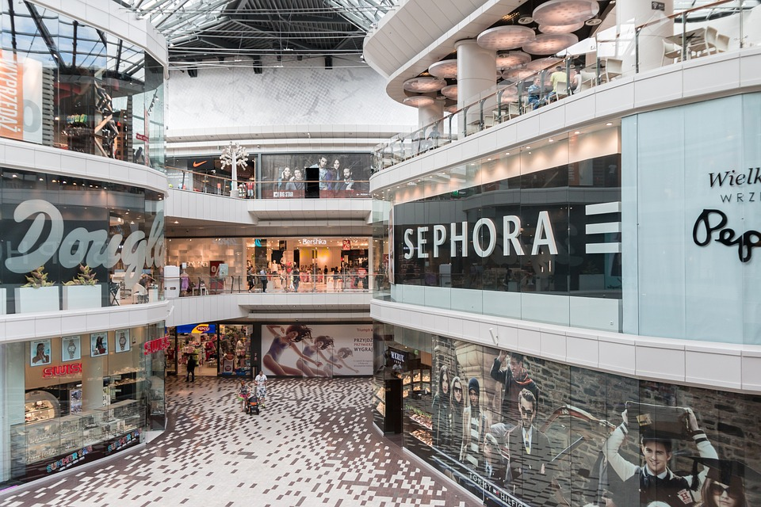
Supermarket Lighting Case
Shopping Mall Lighting Case
www.upshine.com
www.upshine.com

Slide 2
CONTETS
Case Show
Product Introduced
Installation Notes

Slide 3
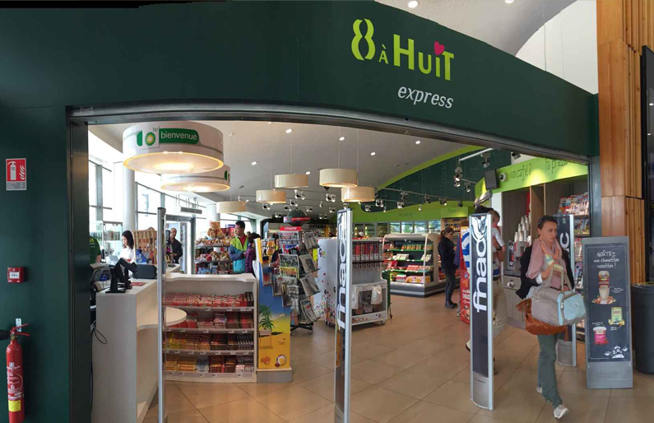
PART ONE
Case Show
Shopping Center
Lighting Case

Slide 4
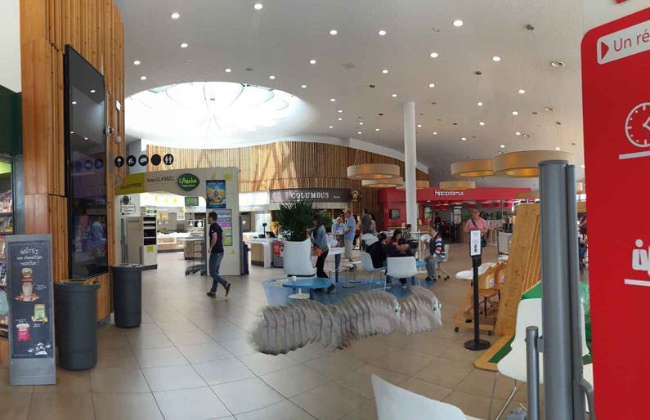
PART ONE
T E X T

Slide 5
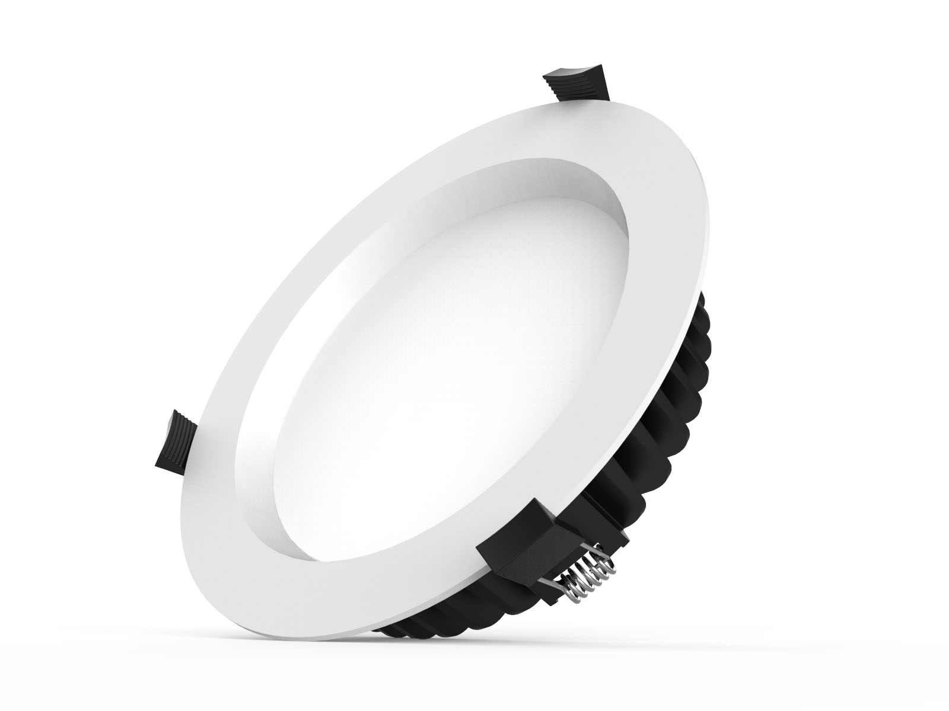
PART TWO
PProduct Introduced
UPSHINE CL59 LED Downlight
Up-shine SMD LED Down light adopts high lumen SMD LED, PMMA diffuser with even light output. White, silver, chrome surface treatments are available for wide choice.
Triac dimmable, 0-10V dimmable and DALI dimmable version share great popularity by excellent dimming effect.
W
S
O

Slide 6
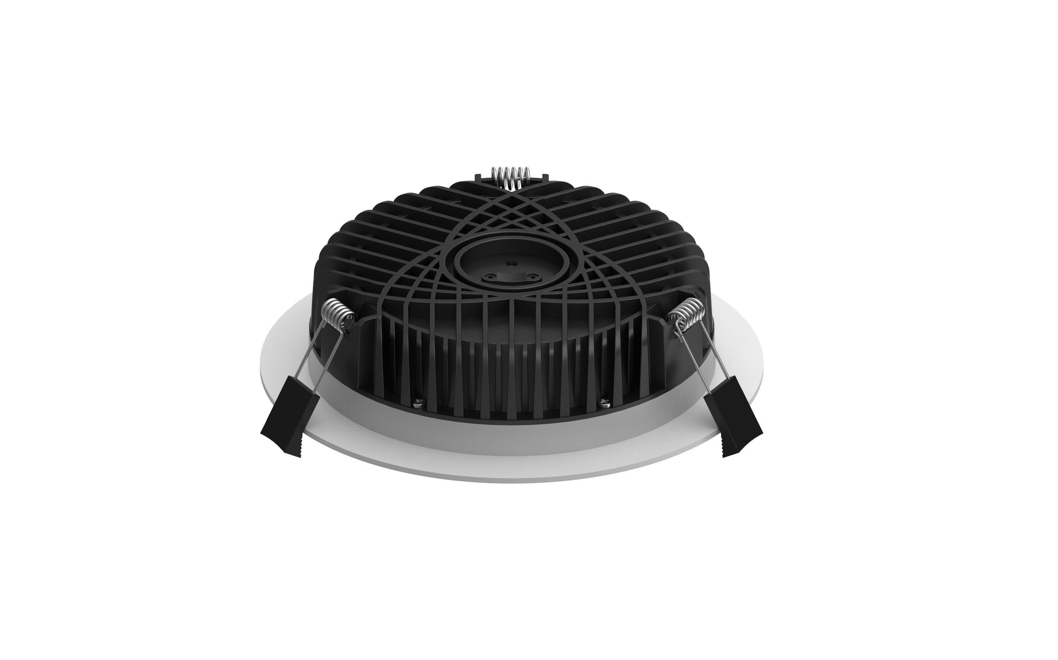
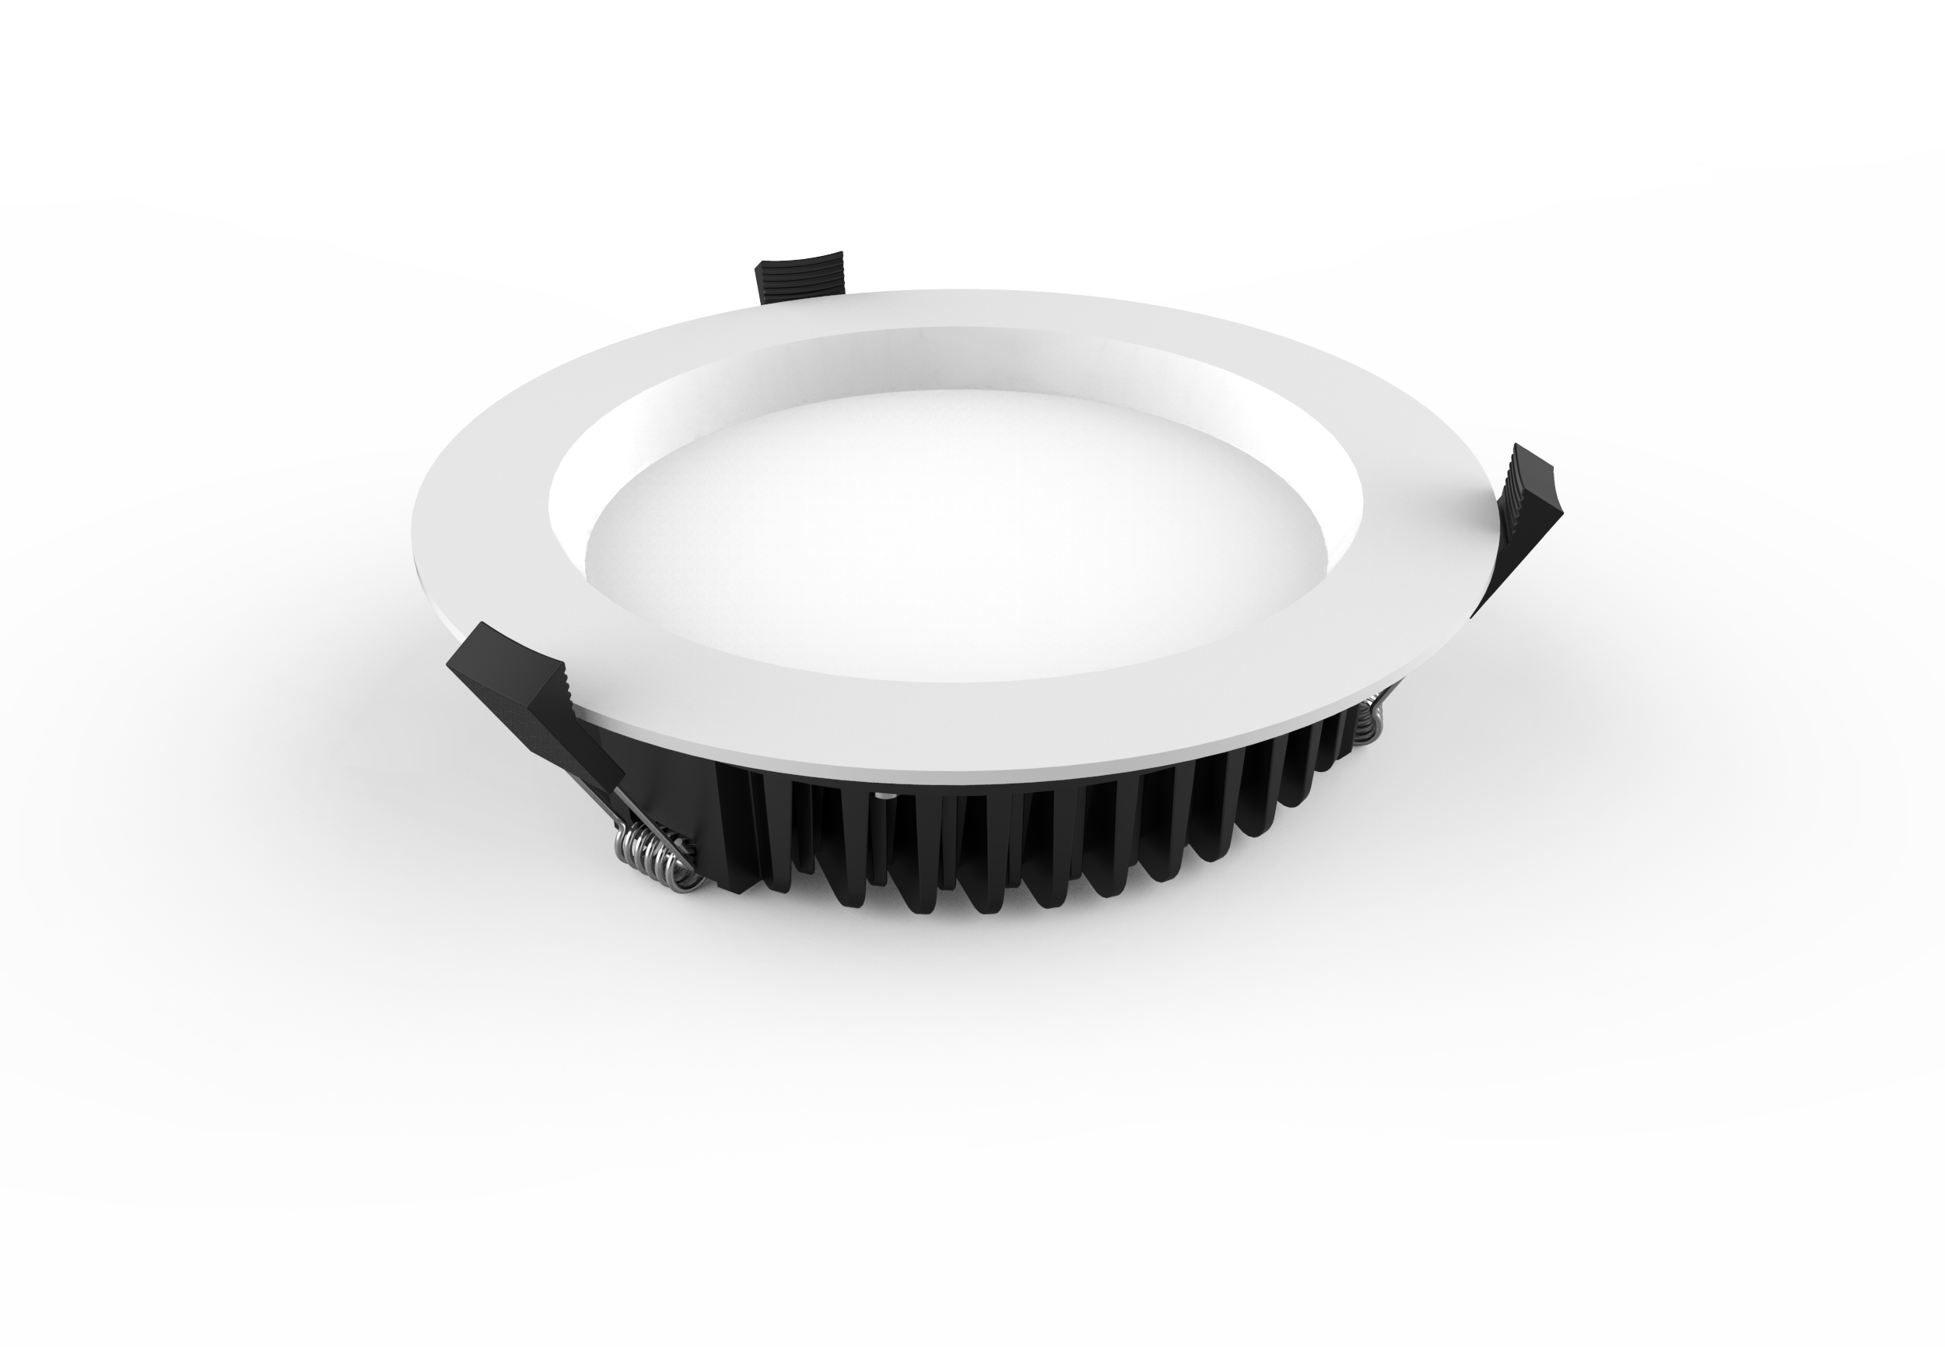

Slide 7
PART TWO
Product Introduced
UPSHINE TL01 LED TRACK LIGHT
Up-shine track light adopts Sharp LEDs with excellent color rendering index to increase the color fidelity of the target illuminated object.
Providing excellent heat dissipation, even light output without glare & dark spot.
Adjustable lighting orientation with 360 degree in horizontal direction and 180 in vertical direction provided. 1-circuit adapter, 3-circuit adapter offered for wide choice.

Slide 8
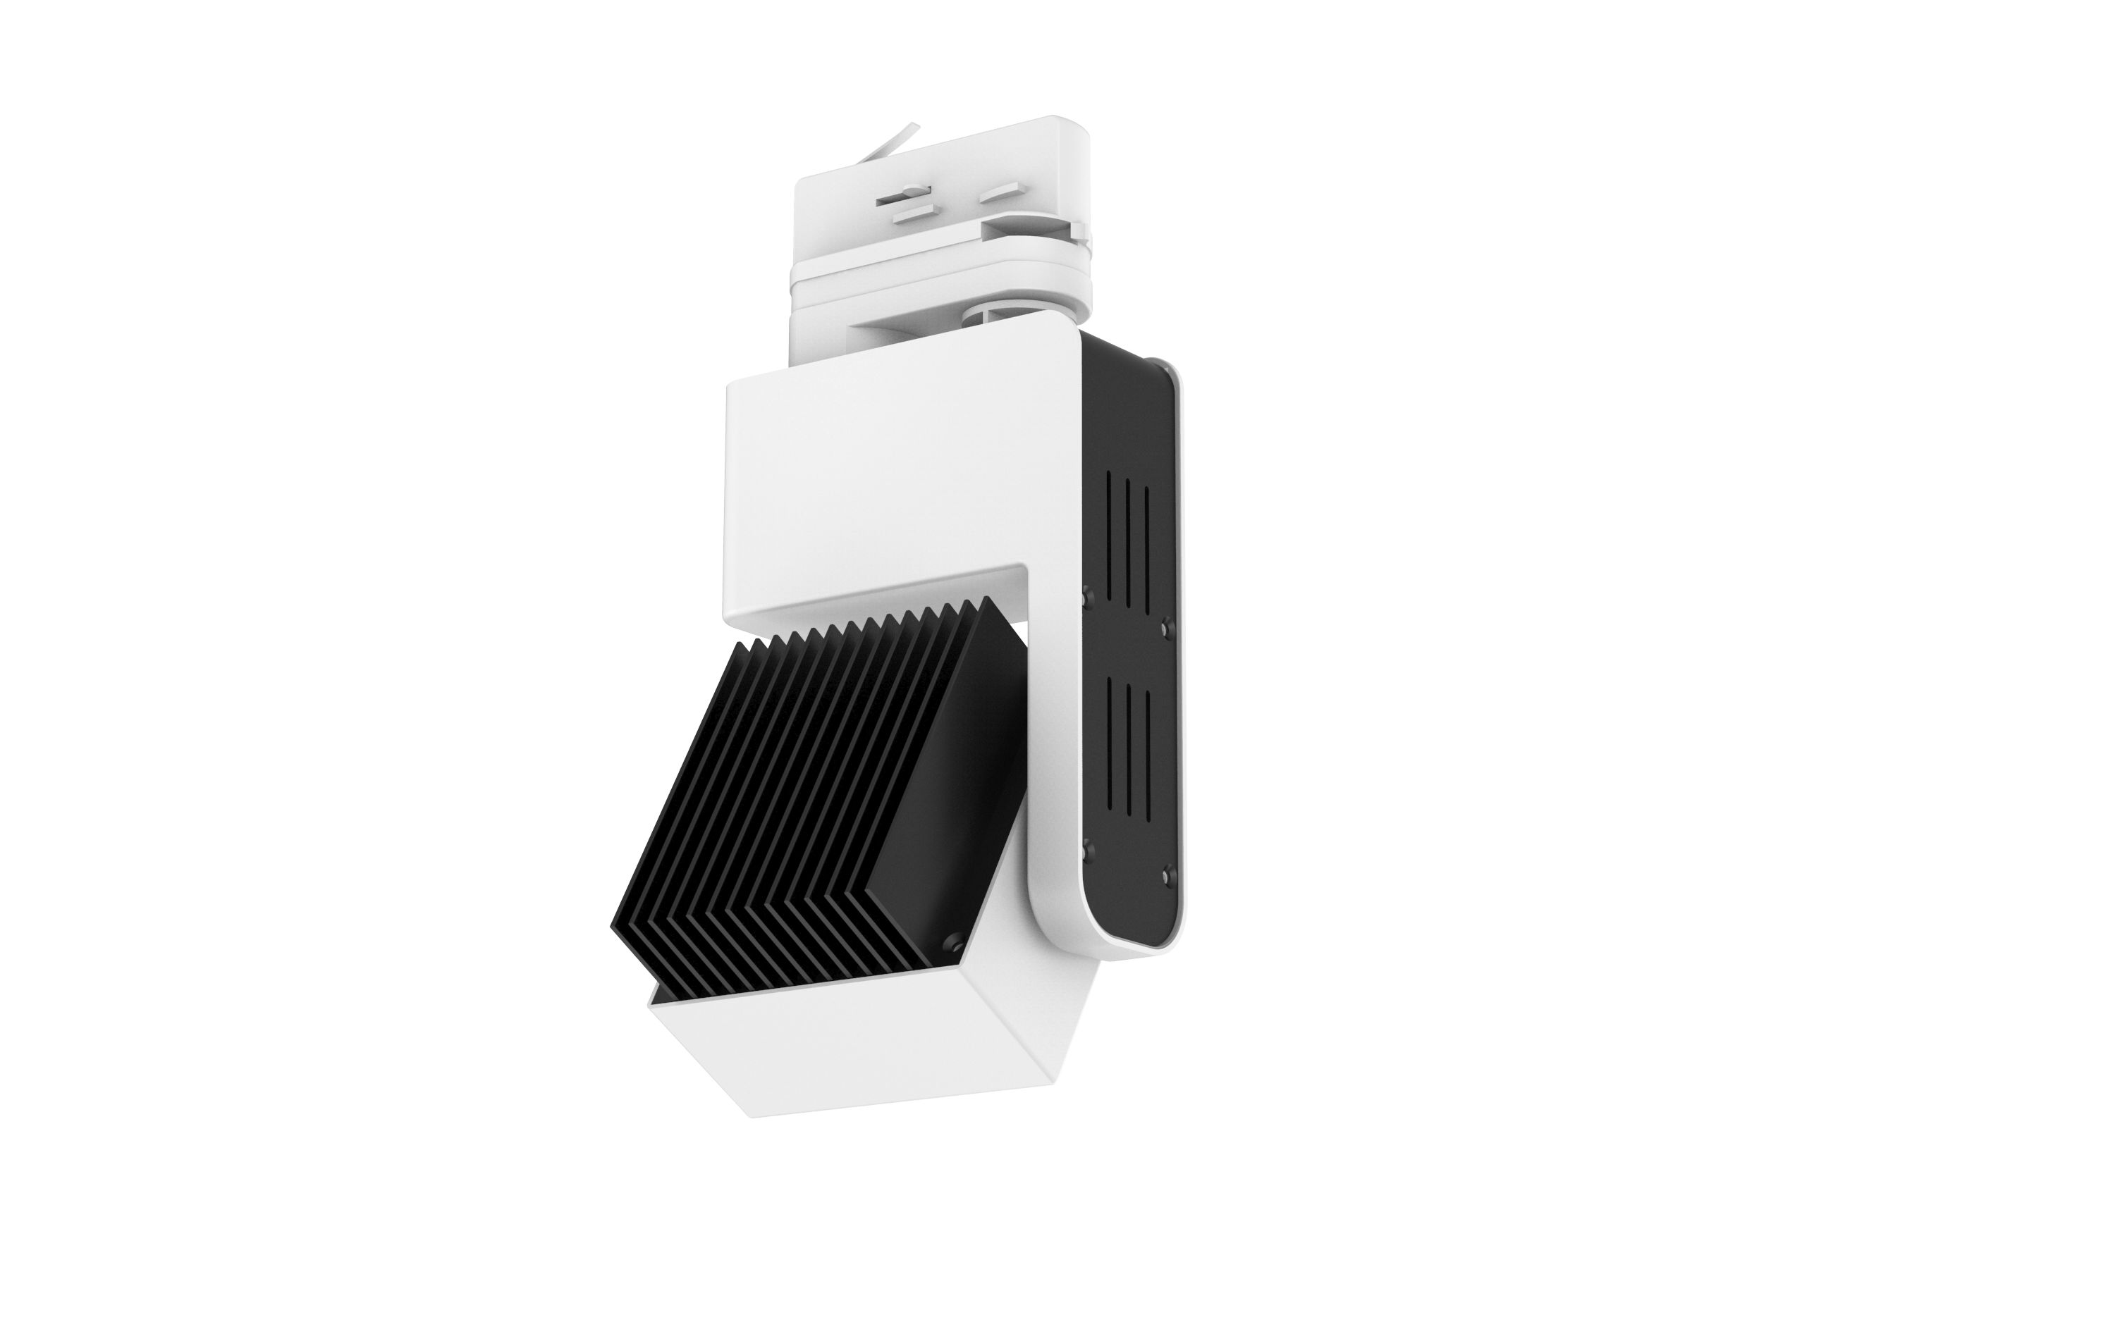

Slide 9
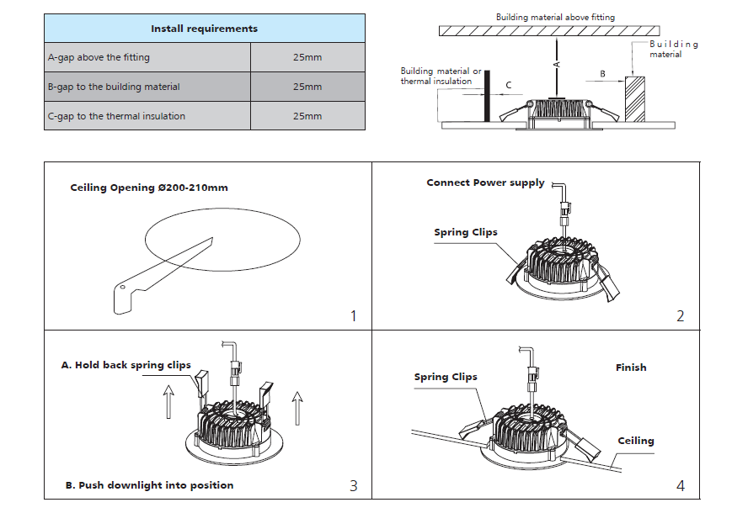
PART Three
CL59 Downlight with Easy Installation
Installation Notes

Slide 10
PART Three
LED Track Light TL01 Installation Guide
Installation Notes

Slide 11
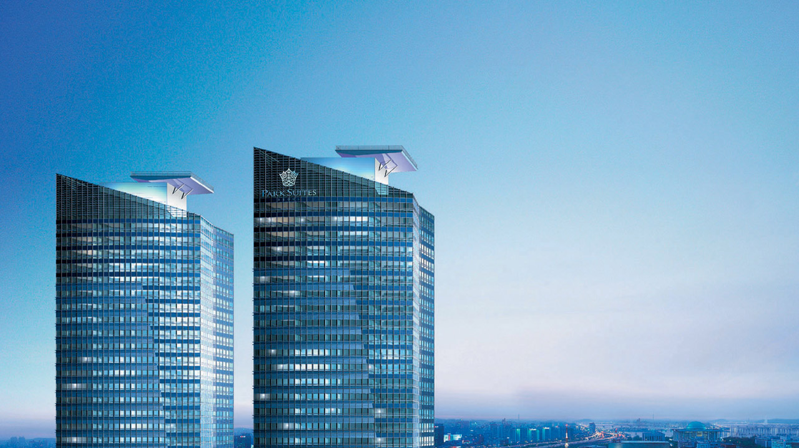
THANK !
WWW.UPSHINE.COM

